Slide 1
Research Poster
Conrad Meyer-Reed

Slide 2
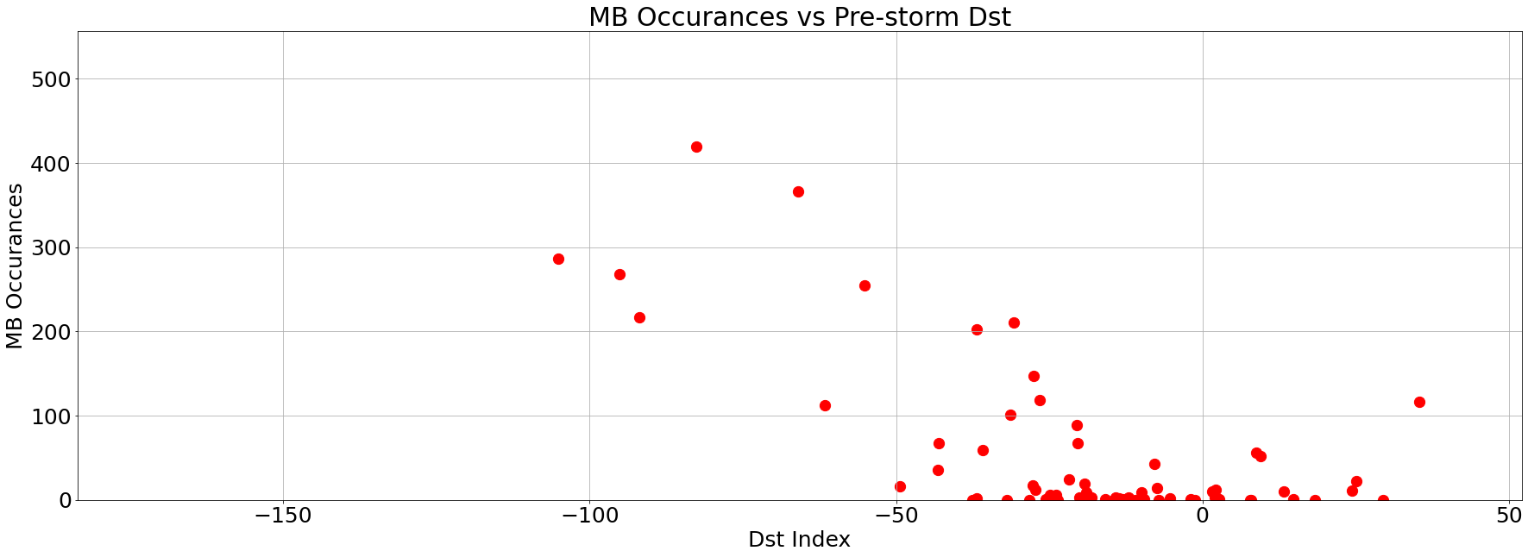
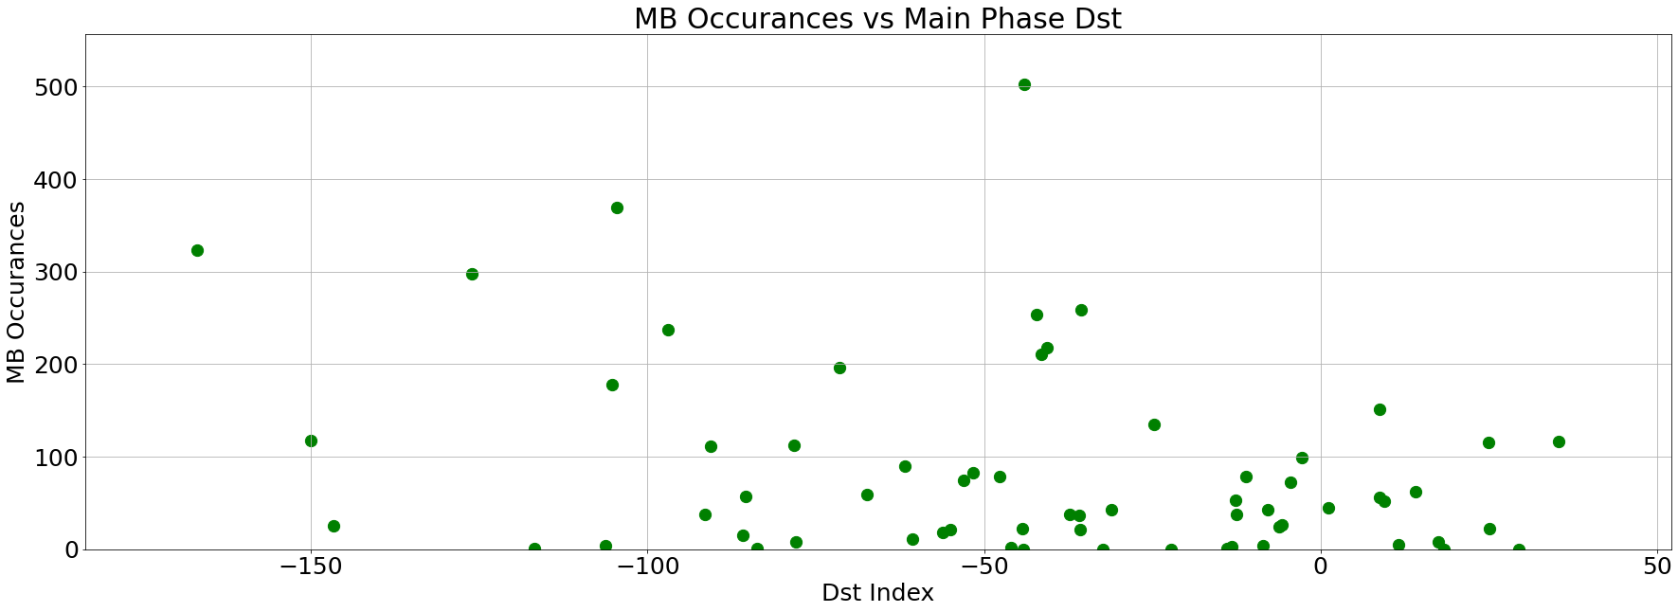
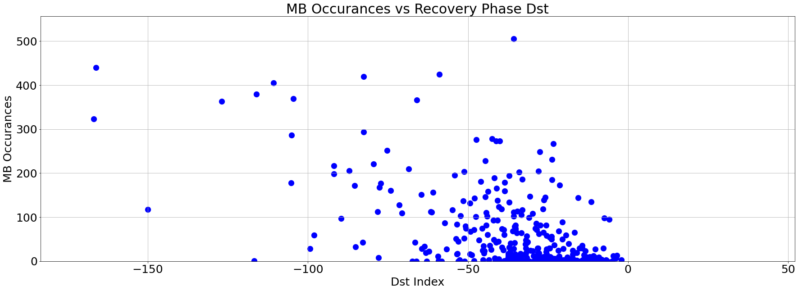
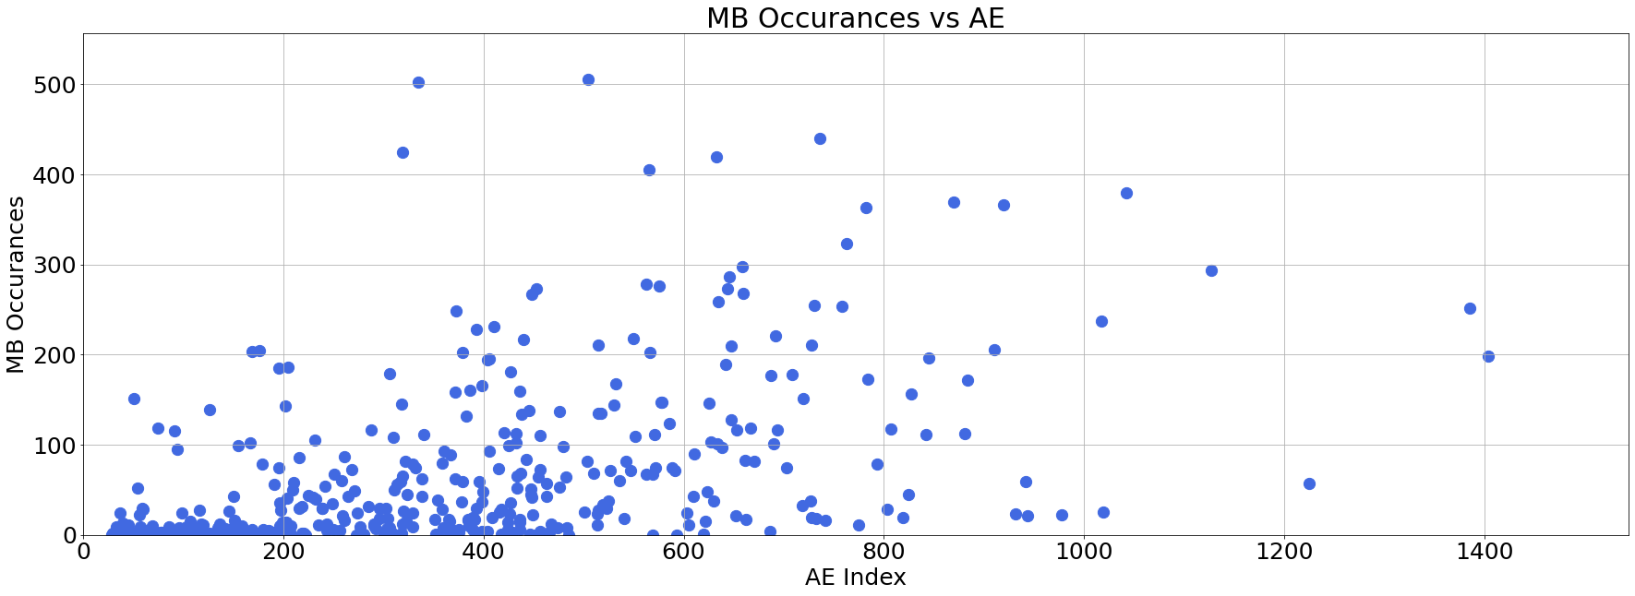
Event Study
1) AE/Dst vs Microburst Occurrences
8 largest storms (<100nT) in 1993 were studied to determine correlations between AE/Dst indices and microburst occurrences
By plotting AE vs MB Occurrence during these storms, a correlation can be found
The same can be done for Dst indices after splitting into three categories:
Pre-storm Phase
Main Phase
Recovery Phase

Slide 3
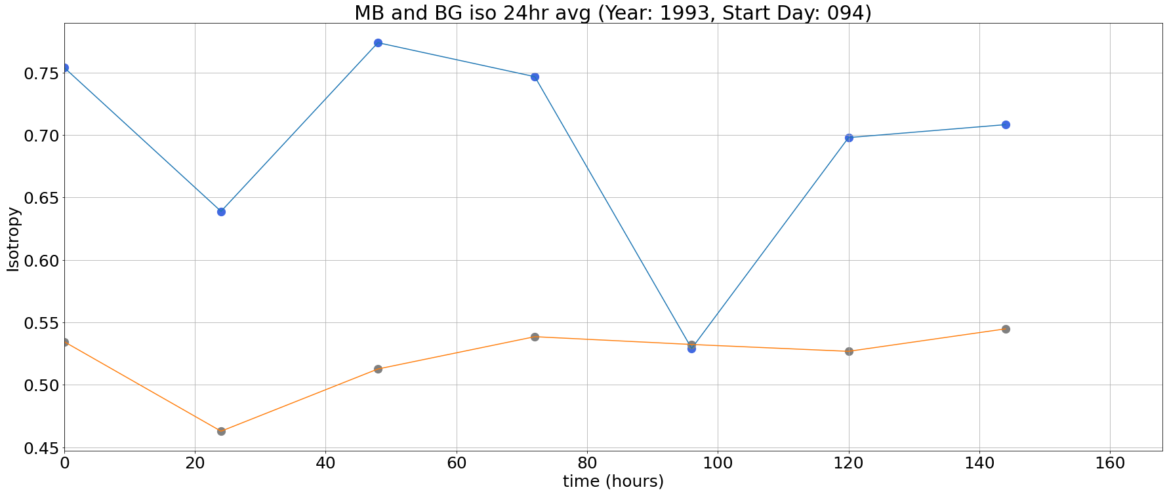
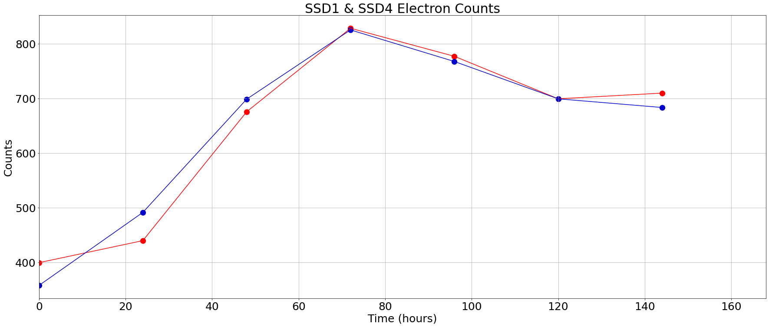
Event Study (cont’d)
2) MB vs BG Isotropy Comparisons
By comparing the microburst isotropy with the background isotropy during each of these 8 storms, we can learn more about the electron loss rate during microbursts
(ask Lauren how to proceed)
Ideas:
Average the MB/BG isotropies for all 8 storms and plot
Figure out better ways of visualizing effects of SSD1 & SSD4 counts on isotropy

Slide 4
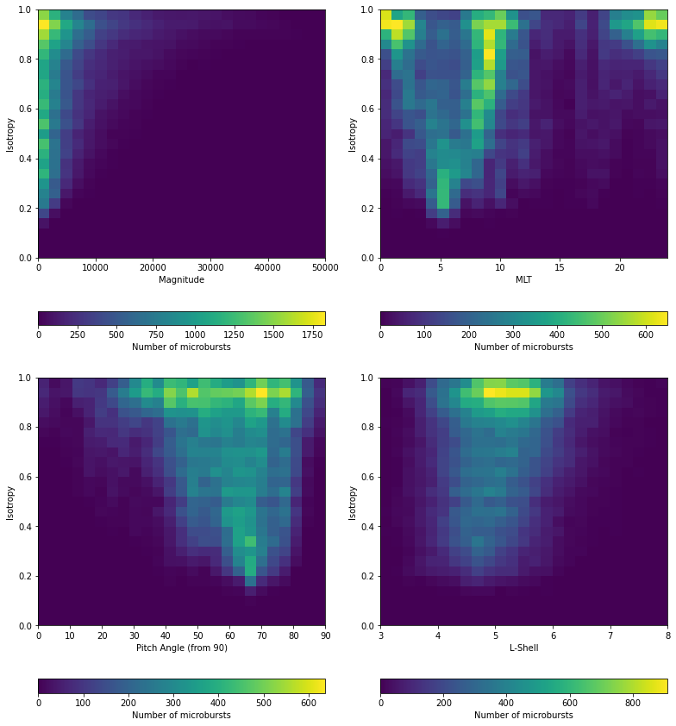
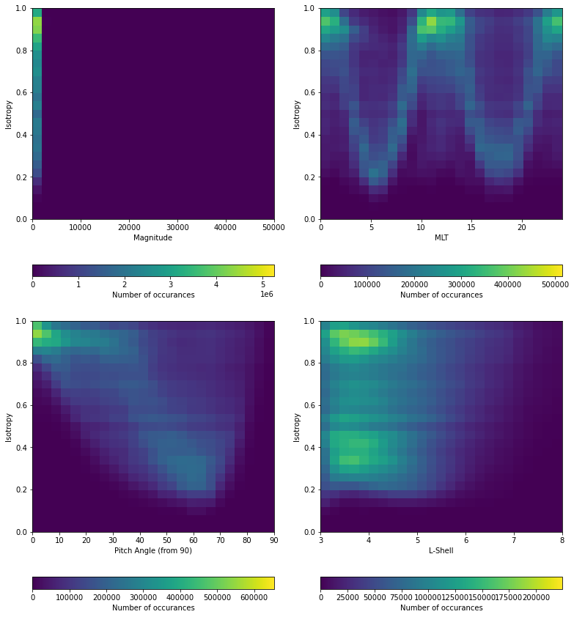
Statistical Analysis
a) Microburst
b) Background
3) MB Isotropy vs Parameters:
Now we can conduct a statistical analysis to find correlations between microburst isotropy and temporal/spatial parameters
To understand how these patterns differ from the background electron counts, we have also plotted background isotropies vs these parameters
The next step is to find a way to conduct a mathematical analysis of the MB Iso Plots vs the BG Iso Plots
Ratio between the two plots (already tried)
Zeros skew results
Dial plot (next page)
Ratio between MB vs Total (MB+BG)?

Slide 5
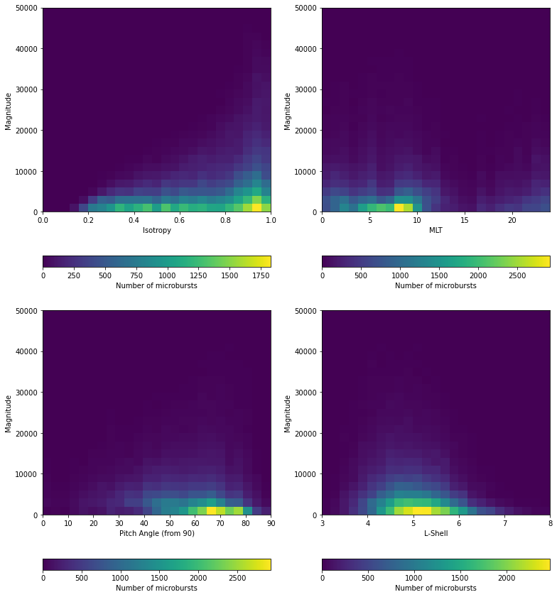
Statistical Analysis (cont’d)
4) MB Magnitude vs Parameters:
5) Dial plot of isotropies vs MLT/L-Shell (?)

